Slide 1
DevSchool
Curs 1

Slide 2
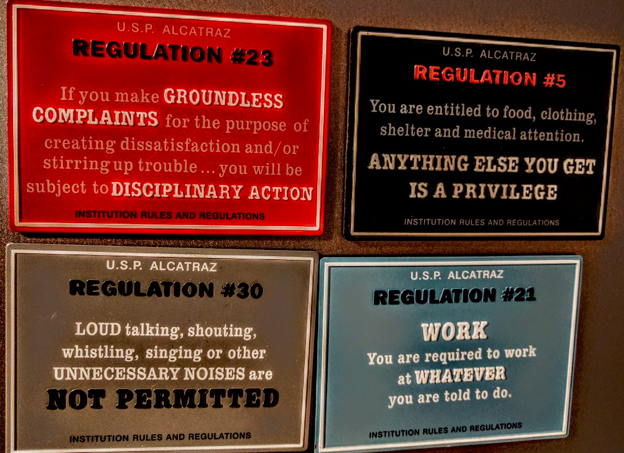

Slide 3
OOP
The basic unit of OOP is a class, which encapsulates both the static properties and dynamic operations within a "box", and specifies the public interface for using these boxes. Since classes are well-encapsulated, it is easier to reuse these classes. In other words, OOP combines the data structures and algorithms of a software entity inside the same box.

Slide 4
Object
What Is an Object?
An object is a software bundle of related state and behavior. Software objects are often used to model the real-world objects that you find in everyday life. This lesson explains how state and behavior are represented within an object, introduces the concept of data encapsulation, and explains the benefits of designing your software in this manner.

Slide 5
Class
What Is a Class?
A class is a blueprint or prototype from which objects are created. This section defines a class that models the state and behavior of a real-world object. It intentionally focuses on the basics, showing how even a simple class can cleanly model state and behavior.

Slide 6
Constructor
A constructor is a special method that has the same method name as the class name.
A constructor is different from an ordinary method in the following aspects:
The name of the constructor method is the same as the class name. By classname's convention, it begins with an uppercase (instead of lowercase for ordinary methods).
Constructor has no return type. It implicitly returns void. No return statement is allowed inside the constructor's body.
Constructor can only be invoked via the "new" operator. It can only be used once to initialize the instance constructed. Once an instance is constructed, you cannot call the constructor anymore.
Constructors are not inherited.

Slide 7
Inheritance
What Is Inheritance?
Inheritance provides a powerful and natural mechanism for organizing and structuring your software. This section explains how classes inherit state and behavior from their superclasses, and explains how to derive one class from another using the simple syntax provided by the Java programming language.

Slide 8
Interface
What Is an Interface?
An interface is a contract between a class and the outside world. When a class implements an interface, it promises to provide the behavior published by that interface. This section defines a simple interface and explains the necessary changes for any class that implements it.

Slide 9
Polymorphism
Polymorphism is the ability of an object to take on many forms. The most common use of polymorphism in OOP occurs when a parent class reference is used to refer to a child class object. Any Java object that can pass more than one IS-A test is considered to be polymorphic.

Slide 10
Package
What Is a Package?
A package is a namespace for organizing classes and interfaces in a logical manner. Placing your code into packages makes large software projects easier to manage. This section explains why this is useful, and introduces you to the Application Programming Interface (API) provided by the Java platform.

Slide 11
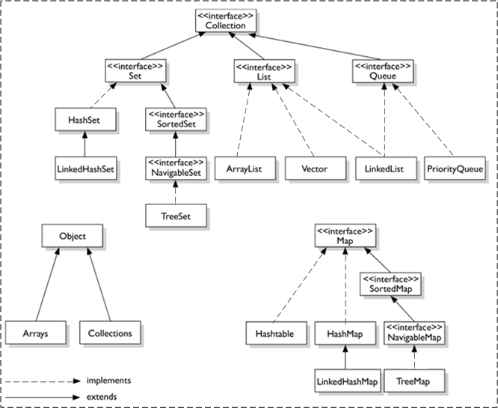
JCF - Java Collection Framework

Slide 12
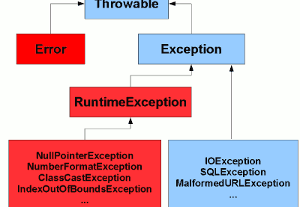
Java Exception Hierarchy

